Slide 1
Island Health Overview
Katie Hopper
HINF 265
Notes:
Hello, my name is Katie, and today I will be providing a quick overview of Island Health, more formally known as the Vancouver Island Health Authority.

Slide 2
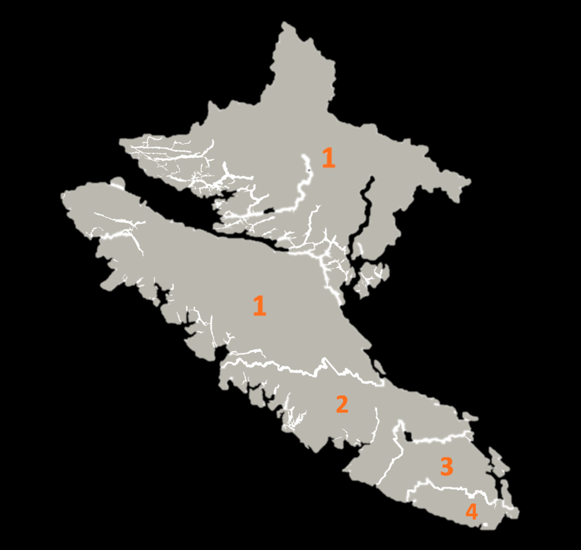
History and Background
Founded in 2001
Vancouver Island
4 Regions
Notes:
Founded in 2001, Island Health is one of the six health authorities in BC. Primarily, Island Health is located on Vancouver Island and is broken up into 4 main geographical regions. Region 1 consists of the upper island (comox to Port Alice) and a portion of the mainland above Powell River. Region 2 includes the central part of the island such as Nanaimo and Tofino, while regions three and four encompass the greater Victoria and surrounding areas. These geographical regions are determined based on patient population density.

Slide 3
Strategic Management
Vision: Excellent healthcare for all
Mission: Provide superior care
Values: C.A.R.E.
Notes:
Island Health is dedicated to providing quality patient care and has committed to this in its Vision, Mission, and Values. Overall, Island Health has a vision of "excellent health and care for everyone, everywhere, every time". The organization will accomplish this through its mission of providing "superior health care through innovation, teaching, and research". As such, Island Health applies the "CARE" values to carry out both its' vision and mission. What this stands for is the "C" or courage to grow, "A" aspire to provide the highest level of care, "R" respect everyone, and finally "E" show empathy to all.

Slide 4
Organizational Structure
Board of Directors
CEO
Vice-Presidents
Notes:
Island Health follows a traditional hierarchal structure, with elected board members in the top position. These individuals are elected based on their decision-making abilities, expertise, and experience. Reporting to these individuals is the CEO and President of the organization. Below the CEO is a number of various vice-president positions who work to foster patient and family-centered care and promote a culture of learning and collaboration.

Slide 5
Culture
Employee Engagement
Employee Longevity
Recruitment
Notes:
For Island Health, organizational culture is something that is taken very seriously. The company assesses its' culture through the use of performance measures that evaluate employee engagement, longevity, and recruitment.

Slide 6
Facilities and Services
150 Facilities
37 Services
Notes:
To accommodate its' large patient population, Island Health has many facilities that offer a variety of services. At Island health, there are a total of 150 care facilities such as hospitals, walk-in clinics, and care homes. Together, these facilities provide 37 unique care services. These services include but are not limited to chronic disease management, imaging and diagnostics, and both acute and long-term care.

Slide 7
Employees
2,000 Medical Staff
20,000 Other Employees
6,000 Volunteers
Notes:
Because of the wide variety of services it offers, Island health has a diverse set of employees. At Island Health, there is 2,000 medical personnel who work alongside 20,000 other employees (such as administrators and analysts). With the support of its' 6,000 volunteers, these employees are able to deliver quality patient care.

Slide 8
Patient Population
794,000 Patients
Diverse Population
Varying health determinants
Notes:
In total, Island Health is responsible to deliver care to a patient population of 794,000 people. This patient population is greatly diverse and consists of individuals of various backgrounds, beliefs, and ethnicities. Because of this, the authority's patient population contains individuals who have varying social determinants of health. These social determinants of health are non-medical factors that greatly impact one's health outcomes.

Slide 9
Financial Contributors and Spending
Community Care
11%
Ministry of Health
Medical Service Plan (MSP)
Private Donations
Residential Care
16%
Acute Care Services
56%
Other
17%
$2.5 Billion Annual Budget
Notes:
Currently, Island Health has an annual operating budget of $2.5 billion dollars. 56% of this budget is spent on acute care, 17% on other services, 16% on residential care, and 11% spent on community care accordingly. Island Health receives its funding for operating from many contributors. However, the Ministry of Health, Medical Service Plan (MSP), and private donations remain the primary financial contributors.

Slide 10
Collaboration
University of British Columbia (UBC)
University of Victoria
(UVic)
Notes:
Island Health collaborates with many organizations to improve care delivery and patient health outcomes. However most notable, is Island Health's collaboration with the University of British Columbia (UBC) and the University of Victoria (UVic). Both universities work with the authority on various research projects. One of which is UVic and Island Health's private medical research into dementia treatment solutions.

Slide 11
Additional Resources
Island Health Key Facilities
Island Health website
Notes:
For additional resources on the Island Health Authority, please feel free to click the links below. The first link is to a Google My Map, that shows some of Island Health’s Key facilities as well as provides some additional information about the facilities and the services they offer. The second link will take you to Island Health’s website, where you can access more information surrounding the authority and the people they serve.
Island Health Key Facilities: https://www.google.com/maps/d/edit?mid=1ZcEcyjaxftQsLyZAhpL3NAMPmUtvXvU&usp=sharing
Island Health Website: https://www.islandhealth.ca/

