Slide 1
Island Health
HINF 265
Katie Hopper
April 2nd, 2020
Notes:
Hello, today we will be exploring the Vancouver Island Health Authority, located throughout the coast of British Columbia.

Slide 2
History and Background
Island Health (VIHA)
Founded: 2001
Located: Vancouver Island, the islands in the Salish Sea and Johnstone Straight, as well as communities north of Powell River and south of Rivers Inlet
Regions: 4
Region 1 consists of the upper island (Comox to Port Alice) and a portion of the mainland above Powell River. Region 2 includes the central part of the island such as Nanaimo and Tofino, while regions three and four encompass the greater Victoria area. These geographical regions are determined based on patient population density.
Notes:
Founded in 2001, the VIHA is one of six health authorities in BC. It is located throughout Vancouver Island, the islands in the Salish Sea and Johnstone Straight, as well as communities north of Powell River and south of Rivers Inlet.There are four regions that Island Health is broken up into. Region 1 consists of the upper island (Comox to Port Alice) and a portion of the mainland above Powell River. Region 2 includes the central part of the island such as Nanaimo and Tofino, while regions three and four encompass the greater Victoria area. These geographical regions are determined based on patient population density.

Slide 3
Mission, Vision and Goals
Island Health (VIHA)
Mission: To provide “superior health care through innovation, teaching and research”
Vision: “excellent health and care for everyone, everywhere, every time”
Goals: C.A.R.E.
Courage, Aspire, Respect, and Empathy
Notes:
VIHA is dedicated to providing excellent services and their missions, visions, and goals show this. In the case of VIHA, their mission is to provide superior health care through innovation, teaching and research. This mission is driven by a mission of providing excellent health and care for everyone, everywhere, everytime. When providing care, VIHA uses their goals more commonly referred to as “CARE” to operate. This stands for the courage to grow, aspire to provide the highest level of care, respect everyone, and show empathy to all.

Slide 4
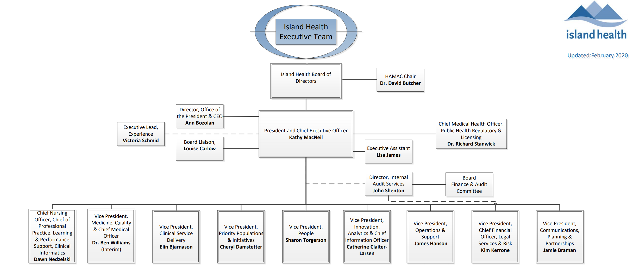
Organizational Structure
Island Health (VIHA)
Follows a traditional Hierarchical Structure
Elected Board of Directors
CEO
Vice-Presidents
Notes:
VIHA follows a traditional hierarchal structure, with elected board members maintain the top position. These individuals are elected based on their decision-making abilities, expertise and experience. Following, there is CEO and President Kathy MacNeil, who is supported by vice presidents. The job of both Kathy and these individuals is to foster patient and family-centered care that promotes a culture of learning and collaboration.

Slide 5
Organizational Culture
Island Health (VIHA)
Measures Culture:
Through the use of performance measures and employee turnover rates.
Improving:
Island Health is constantly trying to improve their workplace and culture.
Notes:
VIHA takes culture very seriously, they measure their organizational culture through the use of performance measures and employee turnover rates. VIHA is constantly trying to improve their workplace culture and create organizational objectives such as employee engagement, recruitment and employee longevity to improve it.

Slide 6
Facilities & Services
Island Health (VIHA)
Total Number of Facilities: 150
Total Number of Services: 37
Services: Aboriginal Care, Chronic Disease and Infections Management, Imaging Testing & Diagnostics, Acute and Long-term Care
Notes:
At VIHA, there are a total of 150 facilities that over a total of 37 services. Such services include (but are not limited to): aboriginal care, chronic disease and infections management, imaging testing and diagnostics, and both acute and long-term care.

Slide 7
Employees
Island Health (VIHA)
Medical Staff: 2,000 people
Other Employees: 20,000 people
Volunteers: 6,000 people
Notes:
In the VIHA, there are a total of 2,000 medical personnel, and 20,000 other employees who are supported by 6,000 volunteers members. These members due various jobs to keep the health authority operating. For example, the medical staff tend to patients, while other employees and volunteers maintain the more business aspects of the organization.

Slide 8
Patient/Consumers/Users
Island Health (VIHA)
Patient Population: 794,000 people
Diversity: extreme patient diversity and
Social determinants of health.
Social Determinants of health: non-medical factors that greatly impact one’s health outcomes. Examples of social determinants
of health include access to education, economic stability, and social circle.
Notes:
At VIHA, they provide care to 794,000 people. Due to the size and variety of the patient population, VIHA has an extreme diversity among its’ patients as well as social determinants of health. Because of this, the authority's patient population contains individuals who have varying social determinants of health. These social determinants of health are non-medical factors that greatly impact one's health outcomes. Examples of social determinants of health include access to education, economic stability, and social circle.

Slide 9
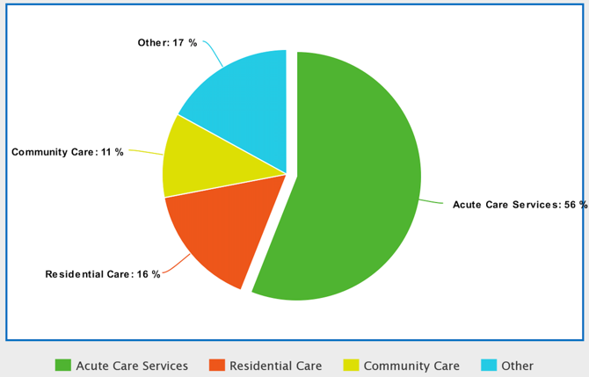
Funding and Expenditure
Island Health (VIHA)
Annual Budget: $2.5 Billion
Primary Expenses:
Acute care (56%)
Residential care (16%)
Community care (11%)
Financial Contributors:
Ministry of Health
MSPs
Private Donations
Notes:
To date, VIHA has a very very large operating budget of $2.5 billion, and spend this primarily on acute care (56%), residential care (16%), and community care (11%) accordingly. This spending model plan has remained consistent throughout the years. The ministry of health MSPs, and private donations remain VIHA main financial contributor.

Slide 10
Collaboration
Island Health (VIHA)
University of British Columbia (UBC)
Patient-oriented research
University of Victoria (UVIC)
Patient-oriented research
Private funded dementia research
Notes:
At VIHA, they are involved in many different collaborative projects. The authority works with both the University of Victoria (UVic) and the University of British Columbia’s (UBC) Island Medical Program. In addition to this, UVic is collaborating with VIHA for private medical research into dementia treatment solutions. These are close relationships that Island Health works hard to maintain. Those who work at the university may one day work at Island Health!

Slide 11
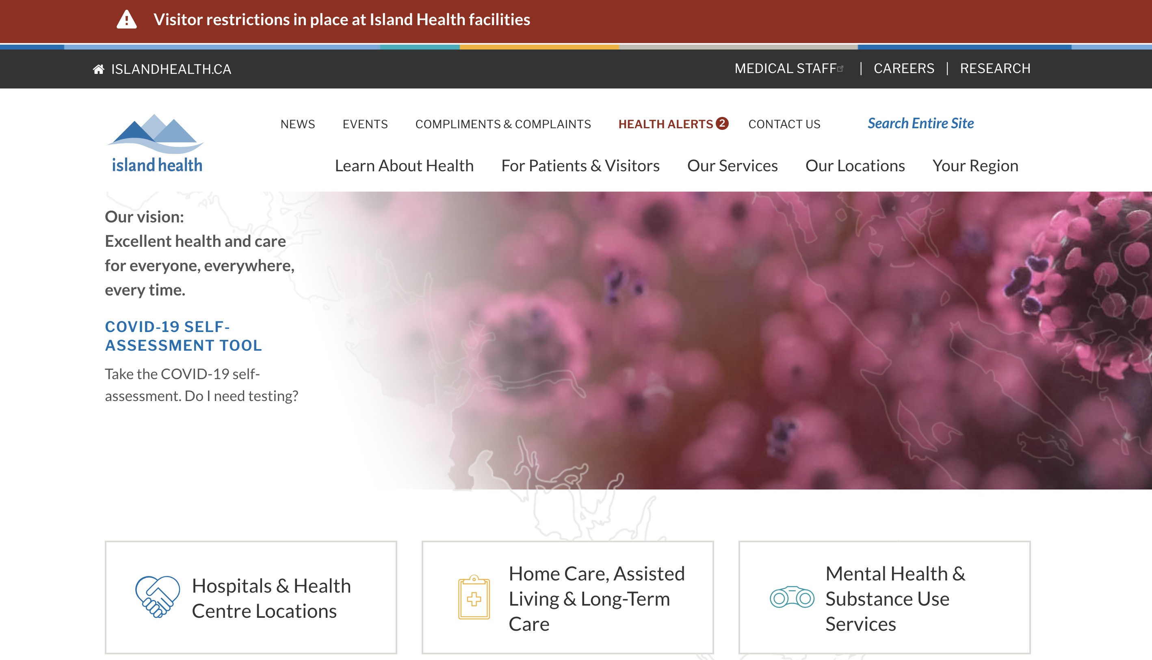
Additional Resources
Island Health (VIHA)
https://www.islandhealth.ca/
Notes:
For more additional resources on Island Health, please refer to the above resource. Thank you.

